Slide 1

Review of Defragmenting the Cloud Using Demand-based Resource Allocation
Luming Zhang ECE, UW-Madison
lzhang338@wisc.edu

Slide 2
Contents
Current solution and its drawbacks when move to public cloud
- Prevent Statistical Multiplexing
New allocation algorithms based on demands
DBS Algorithm
PBX Algorithm
Experimental evaluation

Slide 3
Current Solution and its Drawbacks
Private Cloud VS Public Cloud
Private: over-committing and high consolidation ratios
Public: benefit goes to the service provider
Current public clouds sell capacity in the form of pre-defined VM configurations(peak demands).
Drawbacks
- Prevent Statistical Multiplexing

Slide 4
Give the benefit back!
Sell bulk shareable capacity to tenants rather than pre-defined VM configurations
Requires dynamic resource flow, which is challenging due to physically distributed VMs

Slide 5
Allocation Requirements
Location Obliviousness: allocation should be independent of location
Harmonious Allocation: a VM should not be allocated more than its demand(if any VM is still starve)
Demand-Anomaly Freedom: for VMs with the same share value, a VM with smaller demand get smaller capacity
Share-Anomaly Freedom: for VMs with the same demand value, a VM with smaller share get smaller capacity

Slide 6

Allocation Policies

Slide 7
Centralized Strategy won’t Work
Requires large amount of information to be frequently exchanged between clusters
Centralized algorithms will be CPU intensive due to large number of VMs to consider

Slide 8
Distributed Allocation Algorithms
DBS: Distributed Binary Search
+ Advantage?
Disadvantage?
BPX: Base + Proportional Excess
+ Advantage?
Disadvantage?

Slide 9

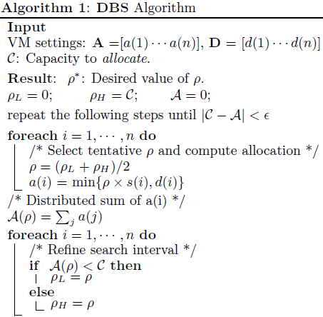
DBS Algorithm (DAP policy)

Slide 10
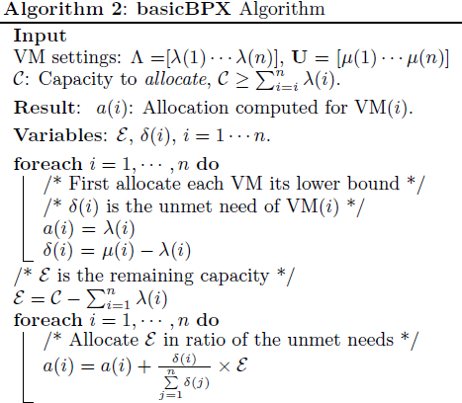
BPX Algorithm (SDAP policy)
A distributed algorithm to start allocation with lower demand bound

Slide 11
Distributed Allocation Algorithms
DBS: Distributed Binary Search
+ Easy to understand
- Multiple synchronous rounds so vulnerable to delays and failures
BPX: Base + Proportional Excess
+ Fully asynchronous distributed algorithm

Slide 12
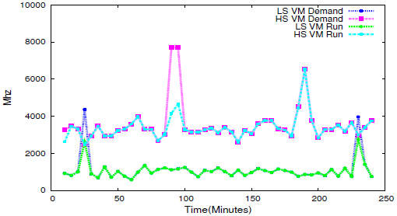
Experimental Evaluation
Single Tenant with Diverse Workload
Figure 5. Demand and consumption(run) of a high-share and a low-share VM

Slide 13
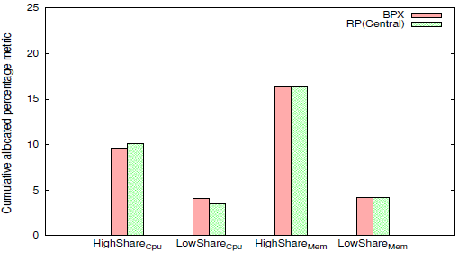
Experimental Evaluation
Single Tenant with Diverse Workload
Figure 6. Cumulative BPX allocations compared with central divvy

Slide 14
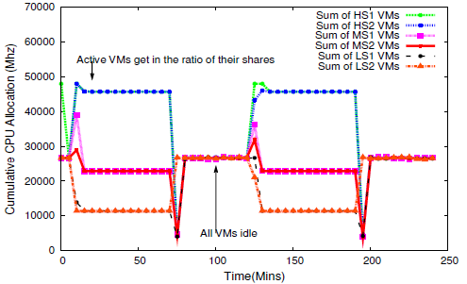
Experimental Evaluation
Large Setup with Coordinated Workloads
Figure 7. Active VM allocations are in the ratio of their shares(4:2:1) when they have enough demand. In low-demand phases, all VMs get similar allocation because the capacity exceeds total demand

Slide 15
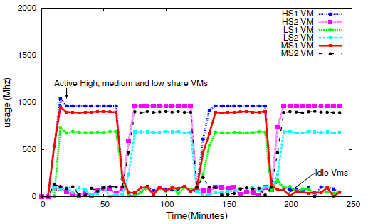
Experimental Evaluation
Large Setup with Staggered Coordinated Workloads
Figure 8. CPU allocation for a high-share, a medium-share and a low-share VM in each of the sets.

Slide 16
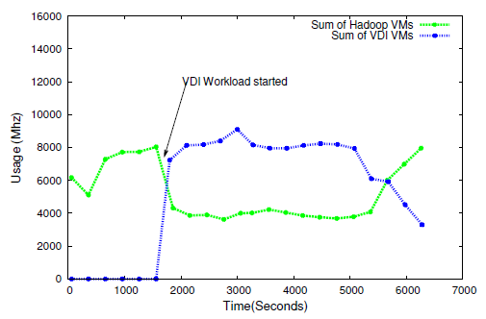
Experimental Evaluation
Real Deployment of Hadoop and VDI VMs
Figure 12. Sum of CPU usage of all Hadoop VMs and VDI VMs.

Slide 17
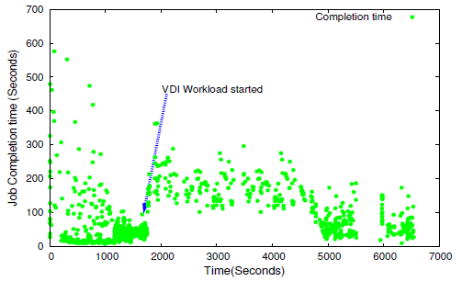
Experimental Evaluation
Real Deployment of Hadoop and VDI VMs
Figure 13. Hadoop job completion times over duration of the experiment.

Slide 18
Thank you!
Thank you for your attention! Any questions?

